Slide 1

Software Testing
Unit 2
Scenario Testing & System Integration
Prof Raghu B. A. Rao
Department of Computer Science and Engineering
‹#›
‹#›

Slide 2

Scenario Testing & System Integration
List of Contents
Scenario Testing
Use-Case Scenarios
Strategies to create good scenarios
Scenario Testing (end-to-end testing)
System Integration
Selecting Integration Method
Integration Testing – Steps
Department of Computer Science and Engineering
‹#›

Slide 3
Scenario Testing
Software Testing Technique that uses scenarios i.e. speculative stories to help the tester work through a complicated problem or test system.
The ideal scenario test is a reliable, complicated, convincing or motivating story the outcome of which is easy to assess.
Usually these tests are different from test cases as the test cases are single steps whereas scenarios cover a number of steps.
Scenario testing is carried out by creating test scenarios which copy the end users usage.
A test scenario is a story which describes the usage of the software by an end user.
Example: Hospital Management System
https://softwaretestingmentor.com/what-is-scenario-testing/
Ecommerce application
Test scenarios for a Banking Site
https://www.guru99.com/test-scenario.html

Slide 4
Scenario Testing
A scenario test has five key characteristics:
Story
Motivating
Credible
Complex
Easy to evaluate
Risks of Scenario Testing:
Scenario testing is complex involving many features.
Scenario testing is not designed for coverage of the program or for test coverage.
Scenario testing is often heavily documented and used time and again.
When the product is unstable, scenario testing becomes complicated.

Slide 5
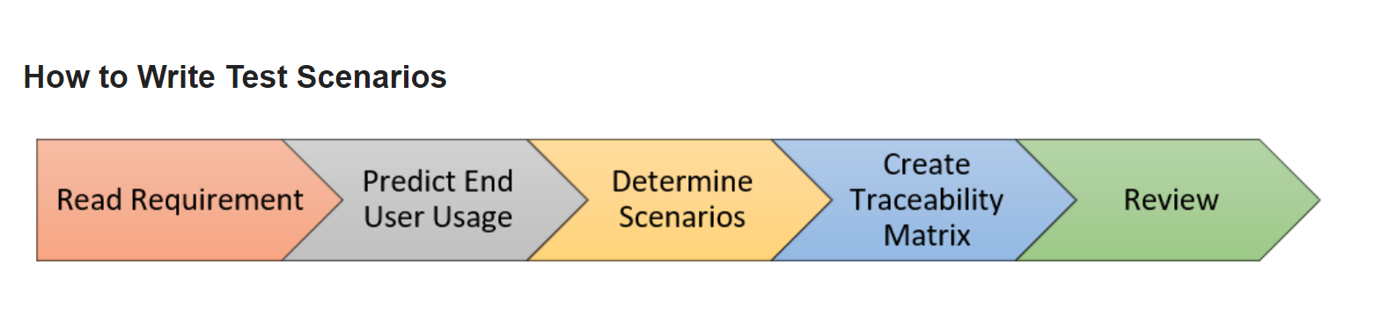
Scenario Testing
Step 1: Read the Requirement Documents like BRS, SRS, FRS, of the System Under Test (SUT).
Step 2: For each requirement, figure out possible users actions and objectives. Determine the technical aspects of the requirement.
Step 3: After reading the Requirements Document and doing your due Analysis, list out different test scenarios that verify each feature of the software.
Step 4: Once you have listed all possible Test Scenarios, a Traceability Matrix is created to verify that each & every requirement has a corresponding Test Scenario
Step 5: The scenarios created are reviewed by your supervisor. Later, they are also reviewed by other Stakeholders in the project.

Slide 6
Test Scenarios for a Banking Site (Example)
Test Scenario 1: Check the Login and Authentication Functionality
Test Scenario 2: Check Money Transfer can be done
Test Scenario 3: Check Account Statement can be viewed
Test Scenario 4: Check Fixed Deposit/Recurring Deposit can be created

Slide 7
Methods in Scenario Testing
SYSTEM SCENARIOS : Scenario tests used in this method are only those sets of realistic, user activities that cover various components in the system.
Story Line, Life Cycle/state transitions, Deployment/Implementation stories from customer, Business verticals, Battle ground
USE CASE SCENARIOS: In use-case and role-based scenario method the focus is specifically on how the system is used by a user with different roles and environment.

Slide 8
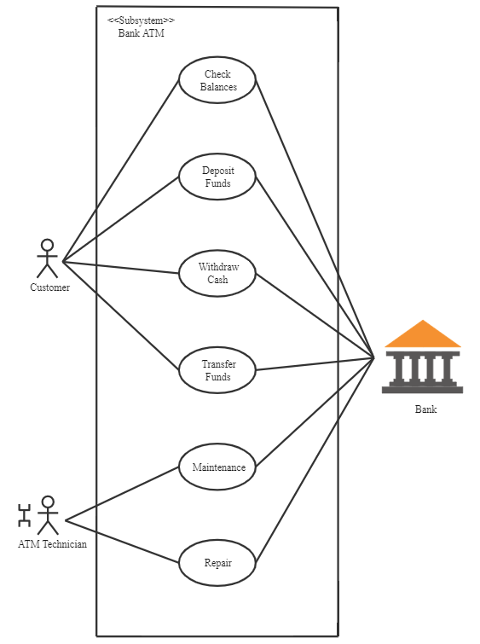
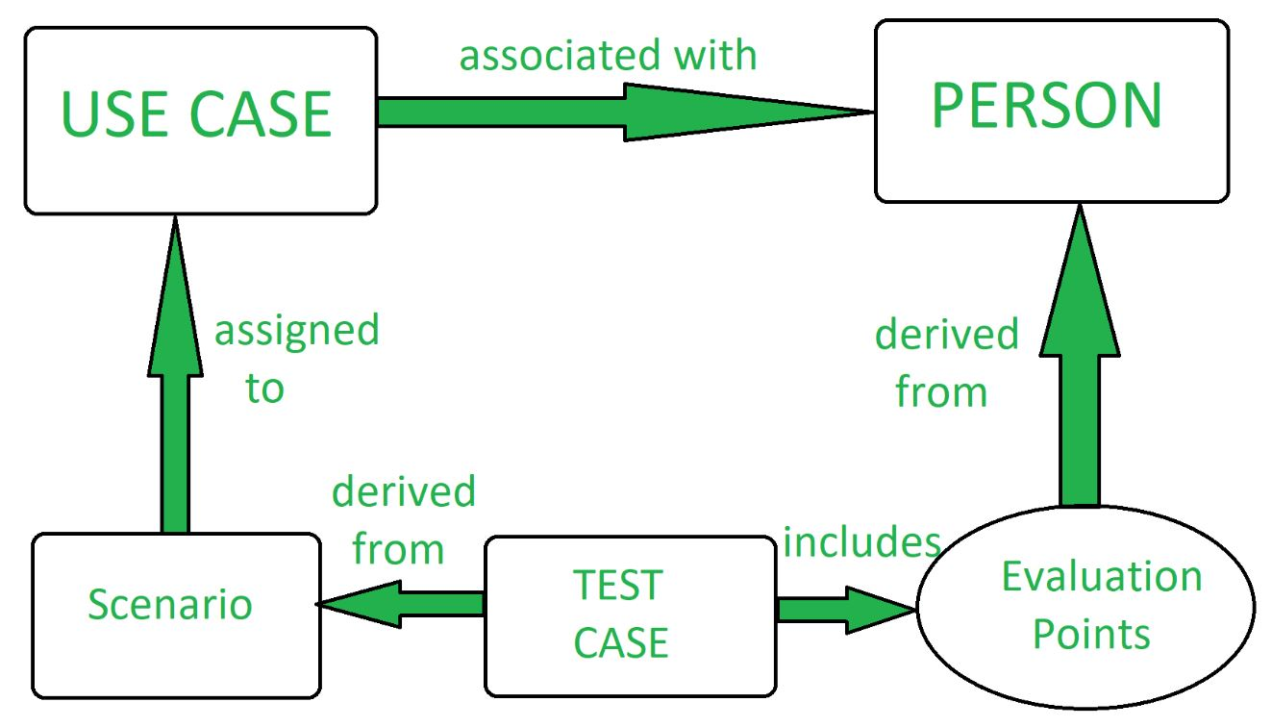
Methods in Scenario Testing Example
(I) SYSTEM SCENARIO
(II) USE CASE SCENARIO

Slide 9
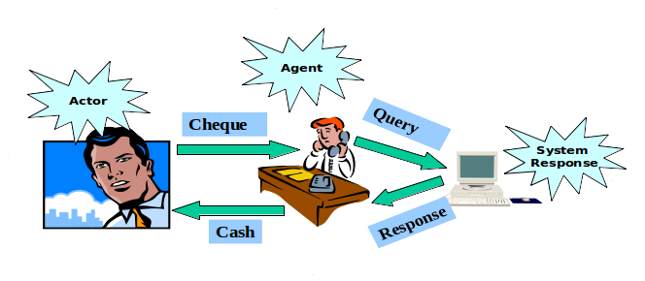
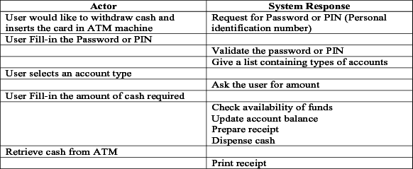
Use Case Scenario (Integration Testing)

Slide 10
Strategies to Create Good Scenarios
Enumerate possible users their actions and objectives
Evaluate users with hacker's mindset and list possible scenarios of system abuse.
List the system events and how does the system handle such requests.
List benefits and create end-to-end tasks to check them.
Read about similar systems and their behaviour.
Studying complaints about competitor's products and their predecessor.
For each requirement, figure out possible users actions and objectives.
Determine the technical aspects of the requirement.
Ascertain possible scenarios of system abuse and evaluate users with hacker’s mindset.

Slide 11
Scenario Testing (End to End Testing)
Testing “full aspect of main functionality” – A business process for example.
Ex. Order processing:
Create customer, create product, collect customer order, prepare making/packing, dispatch, collect money
Focus is on ensuring the full function works and the associated building blocks are integrated well.
This the first step to do full functional test with detailed sub-steps.

Slide 12
System Integration
System integration means that all the components of the system are integrated together and tested as an entire unit.
Advantages:
Saves time & effort.
Disadvantages:
When a failure or defect is encountered during system integration test , it is very difficult to locate the problem.
The ownership for correcting the root cause of the defect may be an issue difficult to pinpoint.
When integration testing happens in the end, the pressure for approaching release date is very high and may affect quality.
A certain component may take excessive amount of time to get ready. This precludes testing other interfaces and integration testing waits till the end.

Slide 13
System Integration
System integration means that all the components of the system are integrated together and tested as an entire unit.
2 types :
Sub System Integration
Final/ system integration
Big Bang Integration – approach in which all software components (modules) are combined at once and make a complicated system. This unity of different modules is then tested as an entity.
Ideal for a product where the interfaces are stable and less number of defects.

Slide 14
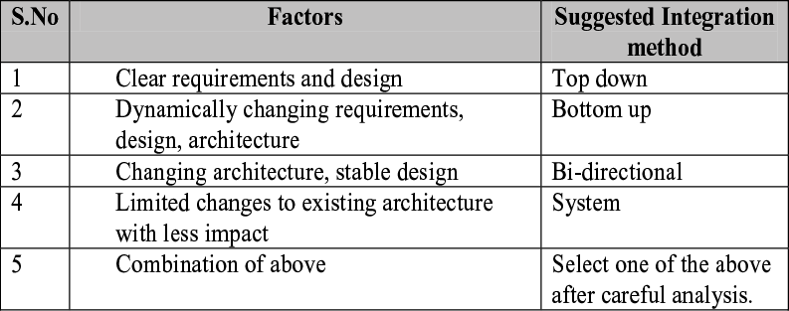
Selecting Integration Method

Slide 15
Steps in Integration Testing
Step 1: Create Test Cases and Test Data
Step 2: Create a Test Plan
Step 3: Once the planned components have been integrated, setup along with environment
Step 4: Execute the test cases
Step 5: Report results
Step 6: Repeat steps 4 & 5 when required – if defects
Step 7: Repeat the above test until all the components have been successfully integrated
Other: Use automation – tools/scripts – where appropriate

Slide 16
THANK YOU
Prof Raghu B. A. Rao
Department of Computer Science and Engineering

